Slide 1

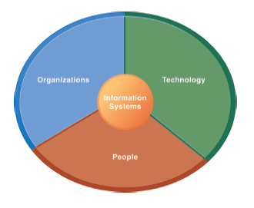
The Institute of Finance Management
ITU08117:
Information Systems Management
BAIT III
Mugyabuso, M. L
2023-2024
Notes:
There are two video cases and two instructional videos available for this chapter.

Slide 2
Aligning Business and IT

Slide 3
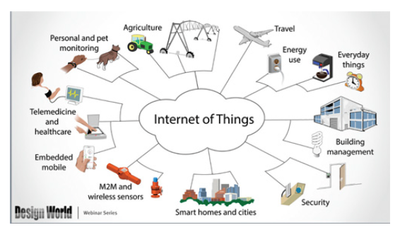

Slide 4
Why Alignment?
It is important because
Any mismatch will not lead to value creation. Mismatch can result into usability issue and obsolescence.
What is Business-IT alignment?
is a dynamic state in which a business organization is able to use information technology (IT) effectively to achieve business objectives

Slide 5
Motivation for Alignment
Trends in the way we do business
IT is an enabler to satisfy customer demands:
Mass customization: mass production of individually customized goods and services, e.g. car industry
Reduce time to market: has become a business requirement in many lines of business, e.g. car industry: new models within few months
bank industry: new financial products with weeks

Slide 6
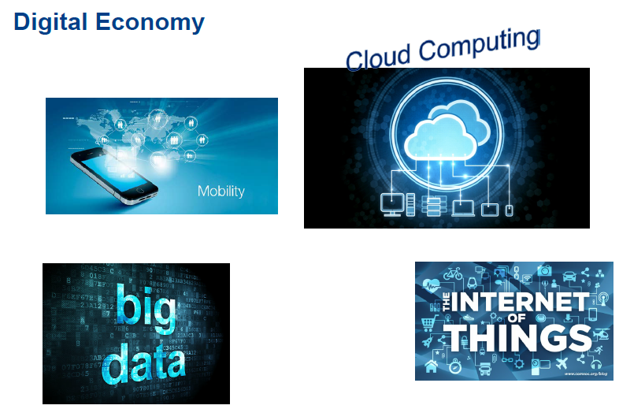
Business and IT Alignment Trend

Slide 7
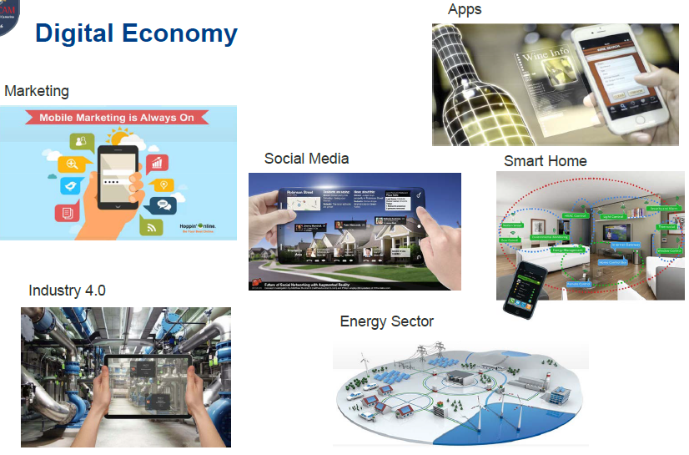
Business and IT Alignment Trend...

Slide 8
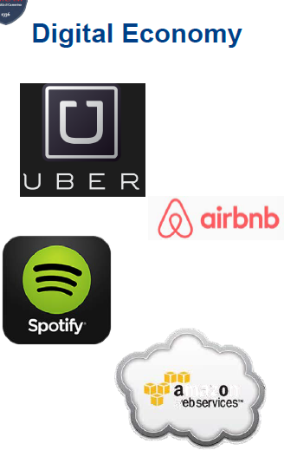
Business and IT Alignment Trend...
Digitalization changes the way of doing business
Platforms and shared economy allow new business models, e.g.
Uber does not own cars
Airbnb does not own apartments
Reachability and mobility: People are always online, which allows ways to interact, e.g. music streaming, online new
Cloud Computing: Adaptive and scalable IT infrastructure by outsourcing

Slide 9
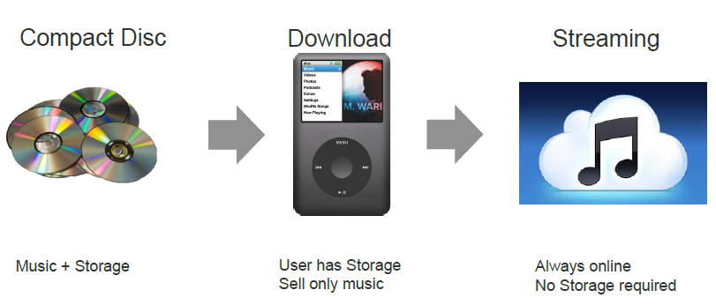
Digital Transformation - Change of Business Models
E.g. Music Industry

Slide 10
Agility: Demand for Continuous Change
To improve their chances of survival, enterprises need to be agile.
Agility is the ability of enterprises to
quickly adapt themselves to changes in their environment and
seize opportunities as they avail themselves
have flexibility to deal with individual customer requirements, to reduce response time to external demands, and to react on events

Slide 11
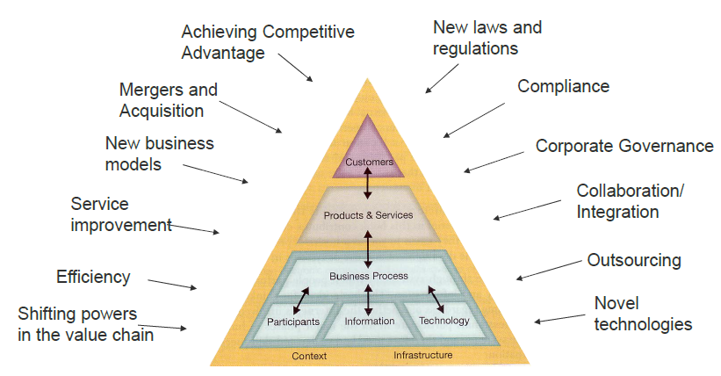
Increasingly dynamic environment: Challenges confronting an Enterprise

Slide 12
Changes on the Operational Level
Agility and change can on operational level:
Optimization of a business process
Replacement of an IT application
Update of an IT application
Re-organisation of a business unit
Outsourcing of a business process
Outsourcing of IT applications to a cloud provider
Implementation of a new information system
Introducing a new collaboration platform
Changes affect both business and IT

Slide 13
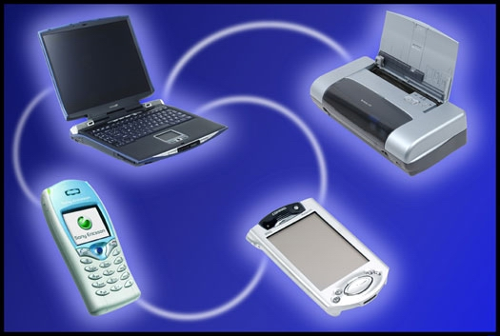
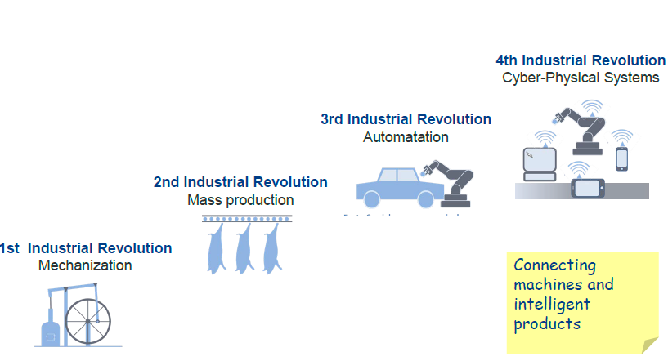
ALIGNING BUSINESS AND IT

Slide 14
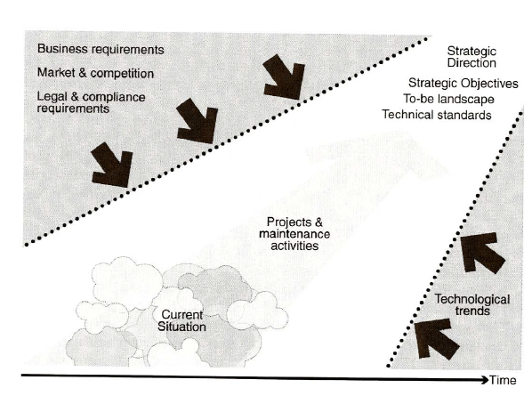
Change Projects
Change projects transform a current situation (as-is) into a future situation (to-be)
The change has to align business and IT.

Slide 15
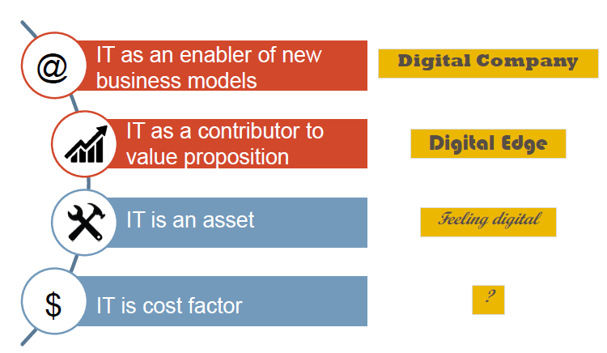
Role of Digitization in Business Strategy

Slide 16
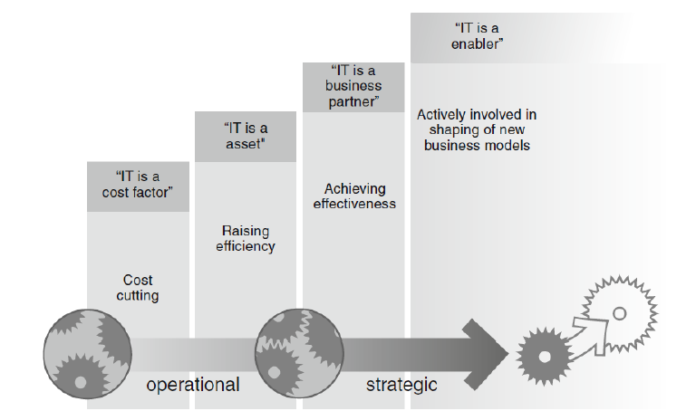
Role of IT

Slide 17
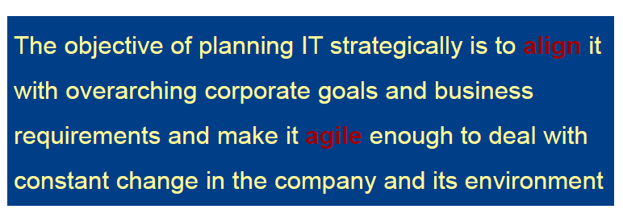

Strategic Planning of Information Technology

Slide 18
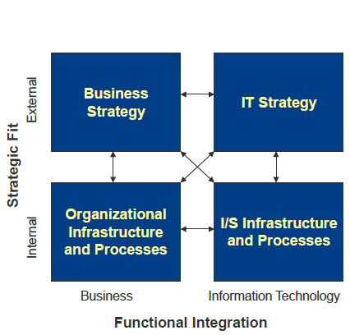
Strategic Alignment Model
The strategic alignment model of Henderson and Venkatraman (1993) combines the two dimensions Aligning business and IT (functional integration)
Aligning intenal and external drivers (strategic fit)
Two principle approaches for alignment:
business-driven: take the business strategy as the starting point and derive the IT infrastructure
IT driven: focus on IT as an enabler; start from IT strategy deriving organisational infrastructure

Slide 19


Drivers for Change can be internal and external
External Drivers
Market Opportunities, new business models
New regulations
Demand for new services and products
Innovations
Internal Drivers
Business Process Optimisation
Increase flexibility
Reorganisation
Migration of Information Systems
Changes in IT infrastructure

Slide 20

Drivers for Change can come from Business or IT
Digitalization: Almost all processes have become IT reliant, if not fully automated.
Thus, there is a mutual influence between information systems and the design of business process
A (re-)design of a business process often demands changes in the IT
Changes in IT applications and information systems can demand a re-design of business processes
New IT may lead to new business models or strategies.

Slide 21
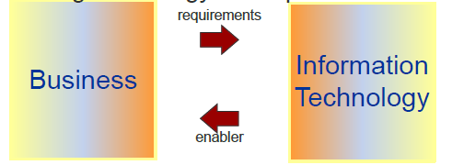
Alignment of Business and IT
There are mutual dependencies between business and IT
The alignment of business and IT has to create an environment in which the IT department and the CIO … are not merely installing technology to support business processes but
are also using technology to shape business strategy.

Slide 22
Additional Infor. For Alignment of Business and IT
The alignment of business and IT is an issue on both strategic and operational level
On strategic level the alignment of business and IT has to deal with problems like the following: What happens to IT if the company has to react on market requirements?
What IT innovations are needed to remain competitive?
How do changes in the IT affect the business?
On the operational level questions can be: Can the new collaboration platform improve the business processes?
What information does the business process need and how can it be stored?

Slide 23
Additional Infor. For Alignment of Business and IT
There are mutual dependencies between business and IT
The alignment of business and IT has to create an environment in which the IT department and the CIO … are not merely installing technology to support business processes but
are also using technology to shape business strategy.

Slide 24
Additional Infor. For Alignment of Business and IT
Business Transformation: Align Operations with Strategy
Business transformation is a key executive management initiative that attempts to align People, Process and Technology initiatives of an organisation more closely with its business strategy and vision to support and help innovate new business strategies and meet long term objectives.
Business transformation is achieved by
re-aligning the way staff work (processes),
how the organisation is structured (people)
how technology is used

Slide 25
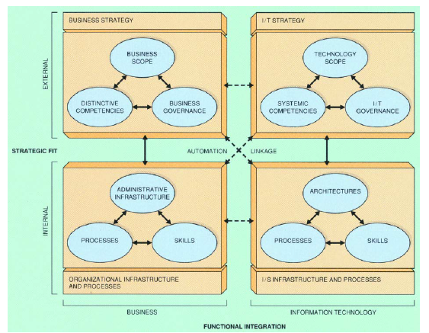
Additional Infor. For Alignment of Business and IT
Strategic Alignment Model – Detailed View

Slide 26
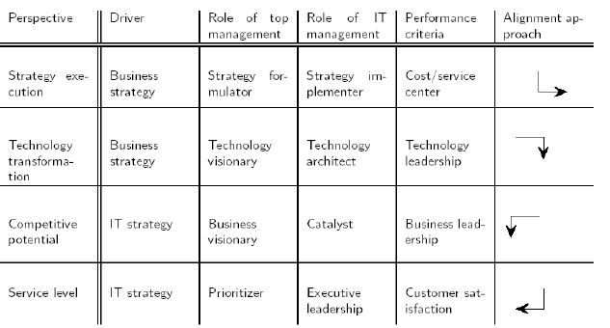
Additional Infor. For Alignment of Business and IT
Four Dominant Strategic Alignment Perspectives

